Slide 1


Workshop on Hybrid Application Development
Dr. Manoj Kumar M V
Assoc. Professor,
Department of Information Science and Engineering,
Nitte Meenakshi Institute of Technology, Bengaluru
http://www.reactopage.com/manoj
manojmv24@gmail.com, manoj.kumar@nmit.ac.in

Slide 2
What is this about?
Android
iOS
Web
Desktop apps

Slide 3

Guess it !
Q1: How many different languages android is available in?
40
50
100+
74
Correct answer is 100+
Ref: https://en.wikipedia.org/wiki/Google_Play

Slide 4
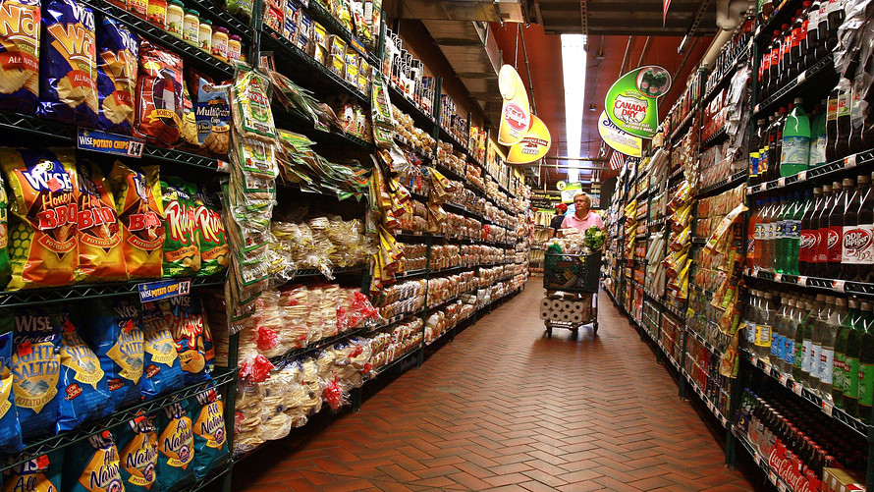
Guess it !
Q2: How many applications are available in Google Play for download?
2.7 million
1.3 million
2.0 million
2.5 million
Correct answer is 3.5 million
Ref: https://en.wikipedia.org/wiki/Google_Play

Slide 5

Guess it !
Q4: How many apps are downloaded from Google play so far?
117 Billion
121 Billion
117 Million
121 Million
Correct answer is 117 Billion
Ref: https://en.wikipedia.org/wiki/Google_Play

Slide 6
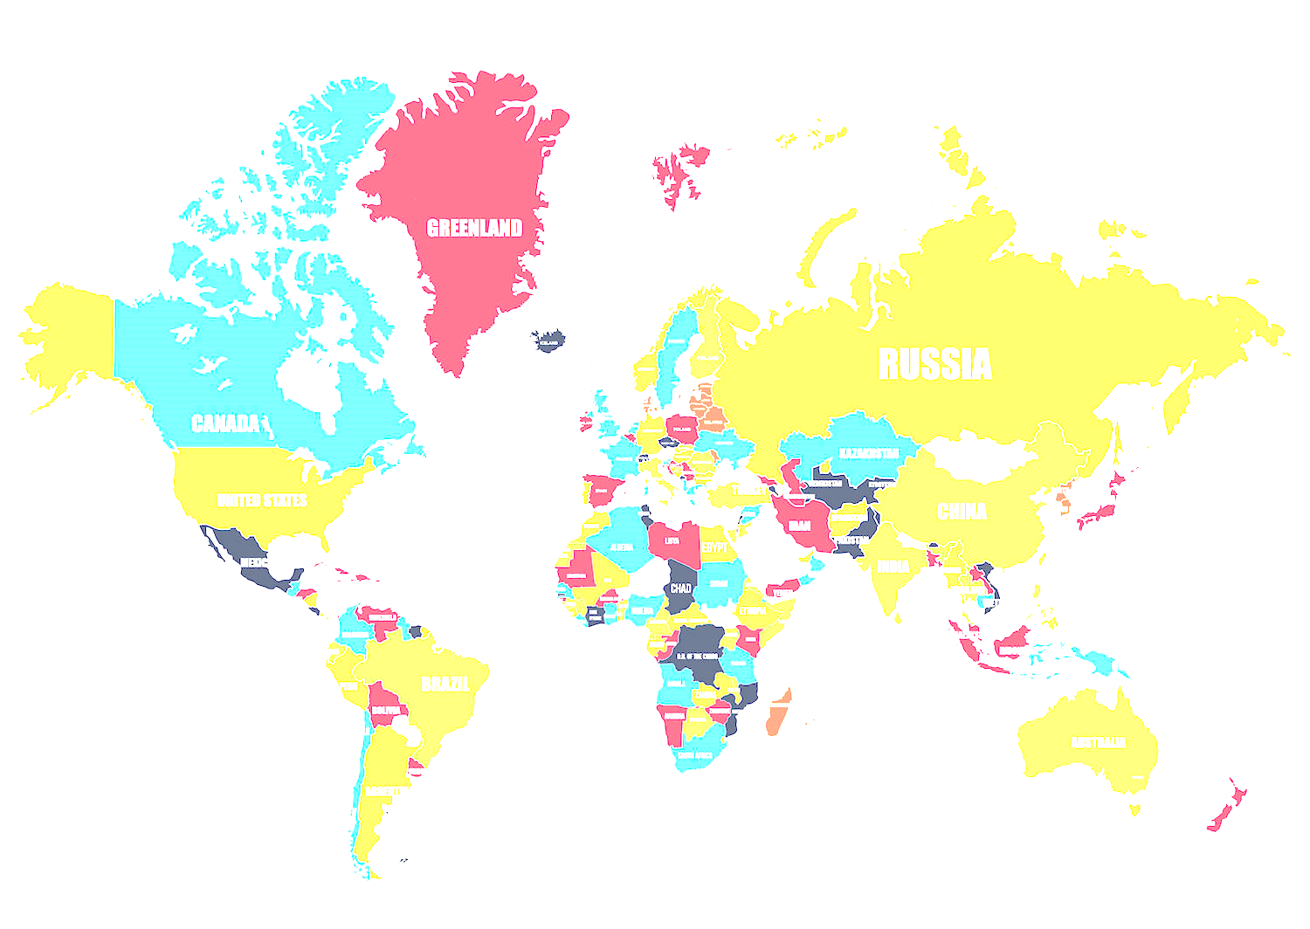
Guess it !
Q3: Users in how many countries can purchase apps through Google play?
145
150
155
130
Correct answer is 145
Ref: https://en.wikipedia.org/wiki/Google_Play

Slide 7
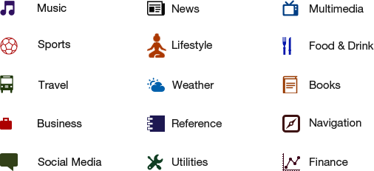

Slide 8
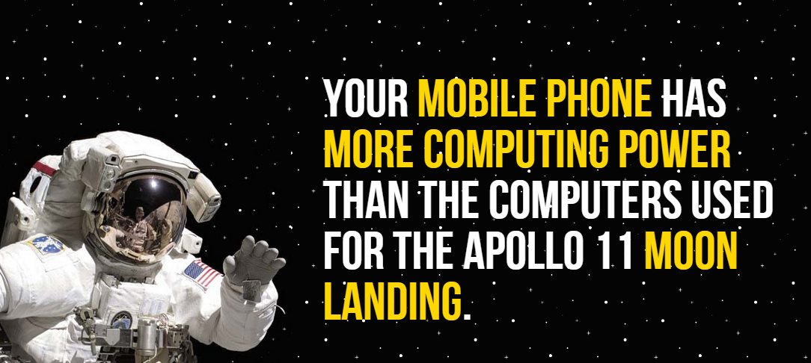

Slide 9

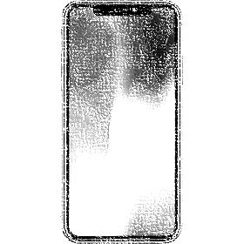
Six of the world's seven billion people have mobile phones - but only 4.5 billion have a toilet, according to a U.N. report.
http://www.dailymail.co.uk/news/article-2297508/Six-world-s-seven-billion-people-mobile-phones--4-5billion-toilet-says-UN-report.html

Slide 10
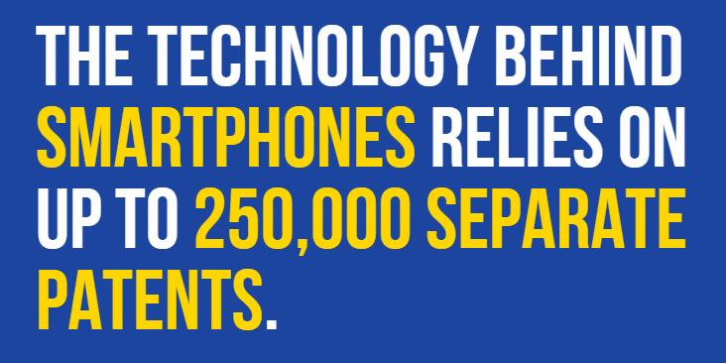

Slide 11


Slide 12

Basic Applications Types

Slide 13
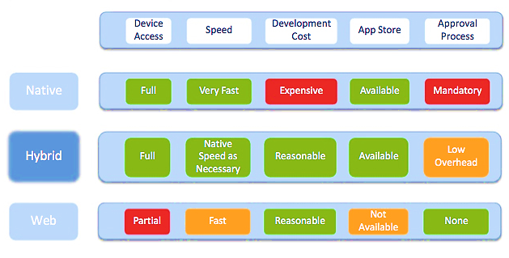

Slide 14
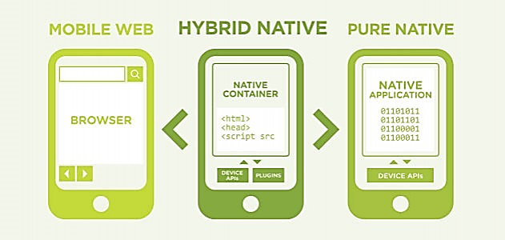

Slide 15
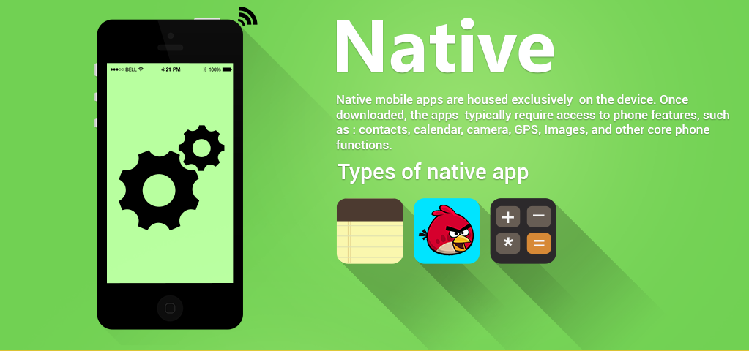

Slide 16
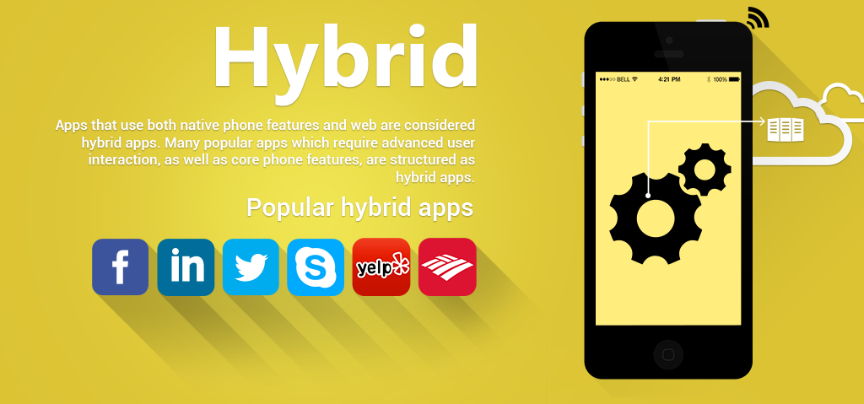

Slide 17
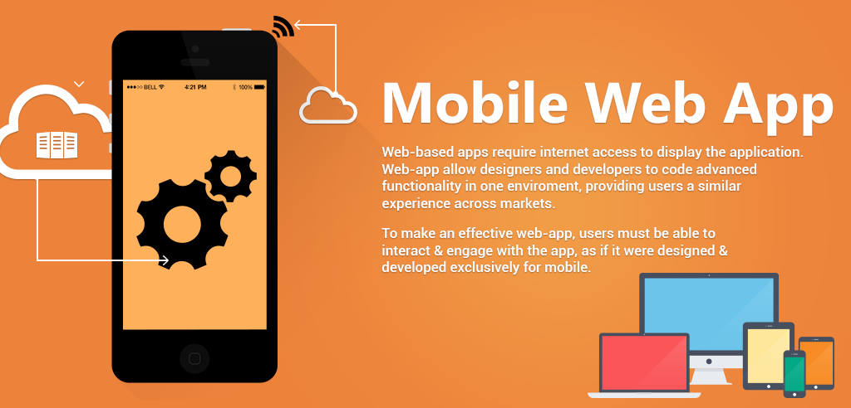

Slide 18

Alternative platforms

Slide 19










Slide 20

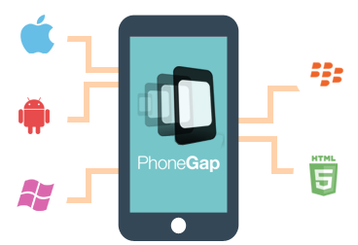
Notes:
PhoneGap is a software development framework by Adobe System, which is used to develop mobile applications.
To develop apps using PhoneGap, the developer does not require to have knowledge of mobile programming language but only web-development languages like, HTML, CSS, and JScript.
PhoneGap produces apps for all popular mobile OS platforms such as iOS, Android, BlackBerry, and Windows Mobile OS etc.

Slide 21
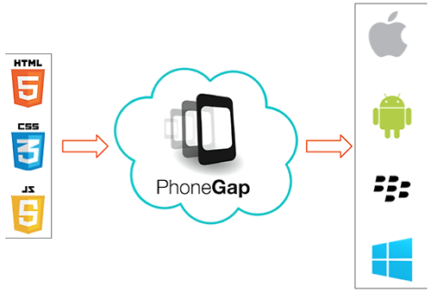

Slide 22
build for
people
loved ones
teachers
small business
artists
living room
love
the road
future
environment
wearables
students
watches
manufacturers
gamers
safety
kids
fitness
yourself
self expression
communities
phones
large screens
everyone
small screens
friends
laptops
tomorrow
tablets
fun
cars
TVs
families
offices
mindfulness
shopping
today
business
good
society
enterprise
augmented realities

Slide 23

Publishing Overview

Slide 24
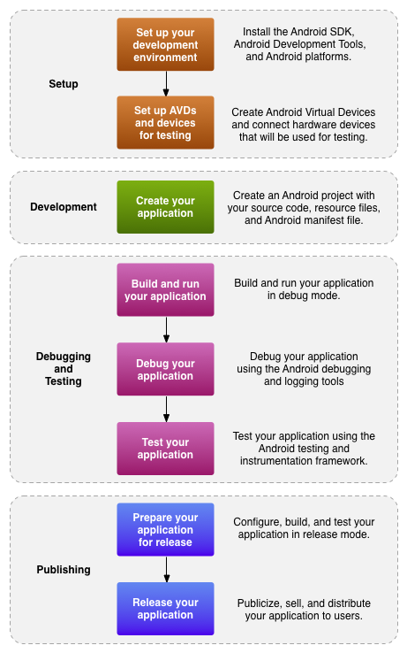
Development Lifecycle

